Slide 1
Air Pollution
Presentation On….
Air pollution sampling and measurement
Measurement of total suspended particulates, PM10 and PM2.5
Industrial dust control methods and equipment
Selection of particulate control device
Air quality standards of Nepal

Slide 2
A Painting of Air Pollution
Picture itself speaks

Slide 3
What is Air Pollution…..?
Fresh Air
Air Pollutant
Air Pollution
Natural Quality of Air
Natural Composition of Air
Solid/ liquid/ gaseous
Injurious to living things/ Property/Environment
Air Pollution Sampling
Taking a sample of air
Determining the level/ concentration of the different Pollutants in Air
Before moving to the steps of Air pollution sampling we need to know about the types of Pollutants

Slide 4
Types of Pollutants
Primary pollutants
Direct emission from sources
CO, NOx, SOx, Pb, HC
Secondary pollutants
Primary pollutants react with other
Acid rain
Organic pollutants
From Organism
Bacteria, Pollen
Non-organic pollutants
Toxics gases and SPM
Dust, fume, mist, spray
Air samples are collected to find out…
What pollutants are in air
What are the levels/concentrations of pollutants in air
To determine the level of pollutants in air that people breathe could be harmful to their health
Illness can result due to level of contamination or duration of exposure

Slide 5
Air Pollution Sampling and Measurement
No single device can measure all the pollutants in a sample of air because it contains different pollutants
To measure the different pollutants, there are different Sampling techniques for different pollutants
Continuous sampling that is on real time measurement of Pollutants
Intermittent sampling that is samples are taken at certain interval of times.
During sampling, proper location must be chosen for sampling
Types of sampling
Types of sampling
Filter sampling
Canister (Can) sampling

Slide 6
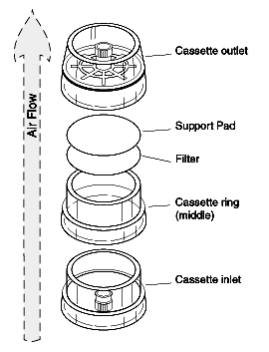
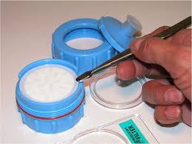
Filter sampling
Uses filter
Particles trap in filter

Slide 7
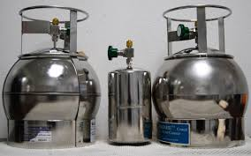
Canister Sampling
Used to measure the gases in air
A pump is used to pump air into the cylinder
After sampling period is over, the canister becomes full of compressed air
The sample of air is tested in Laboratory
Canister cylinder

Slide 8
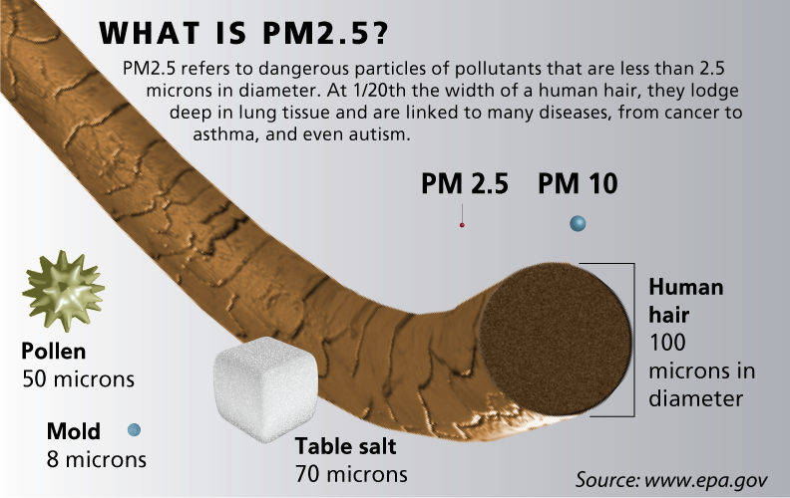
Measurement of Total Suspended Particulate, PM10, PM2.5
PM10 is Particulate Matter of size less than 10 microns
PM2.5 is Particulate Matter of size less than 2.5 microns
Air is drawn into the sampler and through a glass fiber or quartz filter by means of a blower,
particulate material collects on the
filter surface.
The amount of PM is measured

Slide 9
CONTROL METHODS
SOURCE CORRECTION METHODS
Raw material changes (substitution of raw materials): A particular raw material responsible for air pollution is replaced with purer grade raw material. E.g.. Use of low sulphur fuel in place of high sulphur one. Ultra-low-sulfur diesel (ULSD) is diesel fuel with substantially lowered sulfur content.
Process changes (Process modification): New or modified techniques are employed which offer important way of minimizing atmospheric pollutant emissions. E.g.. in chemical and petroleum refining industries, volatile substances are recovered by condensation and non-volatile ones are recycled for additional reactions.
Equipment modification or replacement: Suitable modification or replacement of process equipment help reduce the pollution. E.g. unburnt CO and hydrocarbons can be burnt by injecting air into hot exhaust manifold. (Rao, 2006)

Slide 10
CONTROL METHODS
CLEANING OF GASEOUS EFFULENTS
1. Particulate Control Equipment: Particulate matters are removed by the use of various equipment. They are:
a. From Separators
> Gravitational Settling Chambers
> Centrifugal Collectors
- Single Cyclone Separator
- Multiple Cyclone Separator
b. Fabric Filters
c. Wet Scrubbers
d. Electrostatic Precipitators (“Dust Collector”, n.d.)
2. Gases and Odour Control Equipments: It utilizes equipment for chemical alteration of the pollutant through combustion, catalytic incineration, adsorption, absorption, etc.

Slide 11
POLLUTION CONTROL EQUIPMENT
Control device for particulate contaminants
Control devices for gaseous contaminants
Gravitational settling
Cyclone separators
Fabric filters
Electrostatic precipitators
Wet collectors (Scrubbers)
Spray tower
Venturi scrubber
Cyclonic scrubber
Wet absorption methods
Dry absorption methods

Slide 12
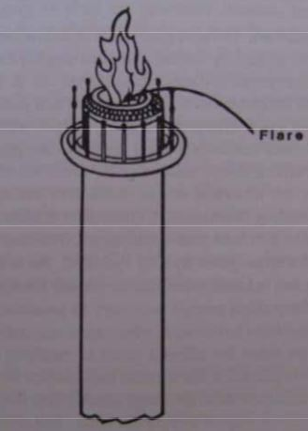
CONTROL EQUIPMENTS
CONTROL OF GAS PHASE EMISSIONS
1. INCINERATION
It is applied to effluent streams containing combustible gases in which the volume flow rate of gas is large and the concentration of the combustible contaminant is relatively low.
a. Direct Flame Incineration
Flare incinerator is a direct flame type system used in petrochemical plants and refineries.
It is used for combustible waste gases that cannot be conveniently treated any other way.

Slide 13
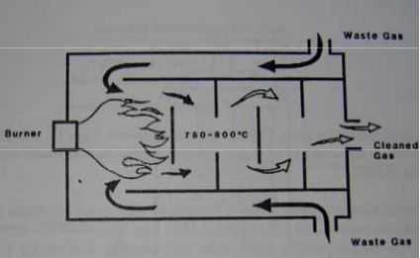
CONTROL EQUIPMENTS
CONTROL OF GAS PHASE EMISSIONS
b. Thermal Incineration
Efficient thermal incineration requires the provision of supplemental fuel to bring the reaction chamber temperature to 750 to 800°C.
It is used to treat effluent streams from a number of industrial processes including varnish cooking, paint bake ovens, meat smoke houses, fat rendering plants, paint application and resin manufacturing.

Slide 14
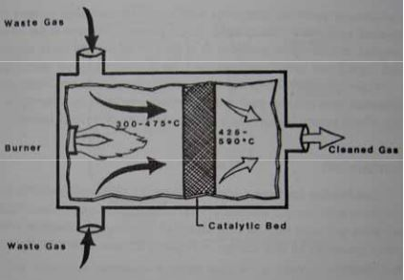
CONTROL EQUIPMENTS
c. Catalytic Incineration
The preheated gases (300-475C) are discharged to a catalytic bed, where combustion occurs.
As effluent gases enter the catalytic bed, they are adsorbed on the surface of the catalyst, increasing the concentration of reacting substances.
Combustion efficiency: 95-98%
It is smaller than thermal incinerator and has less retention time (20-50 times). Retention-the action of absorbing and continuing to hold a substance.

Slide 15
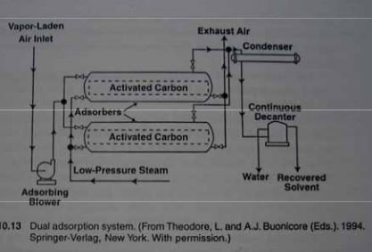
CONTROL EQUIPMENTS
2. ADSORPTION
A variety of contaminant gases can be removed from waste gas streams by being passed through beds or media containing solid sorbents.
Gases coming into contact with solid sorbents may bond to sorbent surfaces (physical adsorption) or may react with sorbent surface (chemisorption).

Slide 16
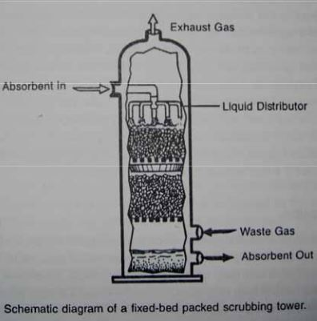
CONTROL EQUIPMENTS
3. ABSORPTION
Gaseous pollutants are absorbed when they come into contact with a medium in which they are soluble or with which they can chemically react.
After the medium is removed from the scrubbing system, absorbed materials must be treated and disposed. For acidic gases waste scrubbing liquids may require neutralization. Solids removal may require the use of settling ponds. Solids generally must be landfilled.

Slide 17
Selection of Particulate Control Device
Particulate matter: They are suspended droplets or solid particles or mixture of the two in the air .
PM may either be Primary pollutant such as smoke particles, or a Secondary pollutant formed from the chemical reaction of gaseous pollutants such as dust, smoke, plant spores, bacteria, salt, fumes, mist, fog, aerosol e.t.c .

Slide 18
Human activities resulting in PM in Air
PM
Mining
Fossil Fuels
Transportation
Incinerators
Industrial Discharges

Slide 19
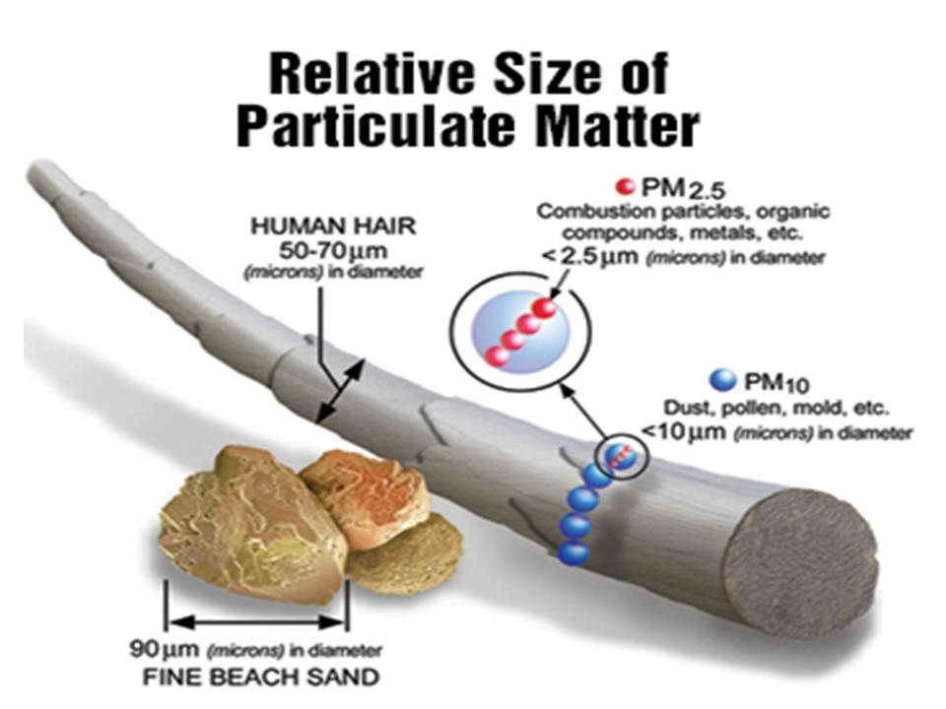

Slide 20
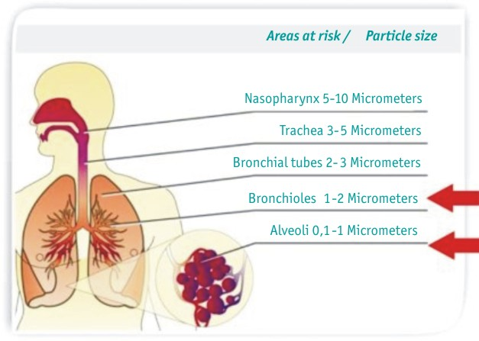

Slide 21
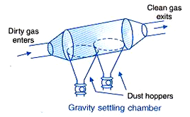
CONTROL EQUIPMENTS Particulate Control Equipments
GRAVITATIONAL SETTLING CHAMBER
Used to remove large abrasive particles (usually >50 µm).
Particles settle under gravitational force.
Usually used as pre-cleaners prior to passing the gas stream through high efficiency collection devices.
a. Expansion Chamber Type
Velocity of the gas stream is reduced as the gas expands in large chamber.
The reduction in velocity allows larger particles to settle out of the gas stream.

Slide 22
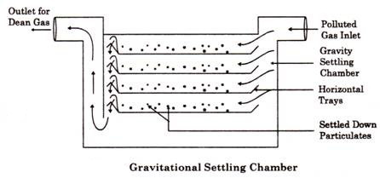
CONTROL EQUIPMENTS
GRAVITATIONAL SETTLING CHAMBER
b. Multiple Tray Chamber Type (Howard Settling Chamber)
Contains a number of thin trays closely spaced within the chamber, which causes the gas to flow horizontally between them.
The several horizontal shelves or trays improve the collection efficiency by shortening the settling path of the particles.

Slide 23
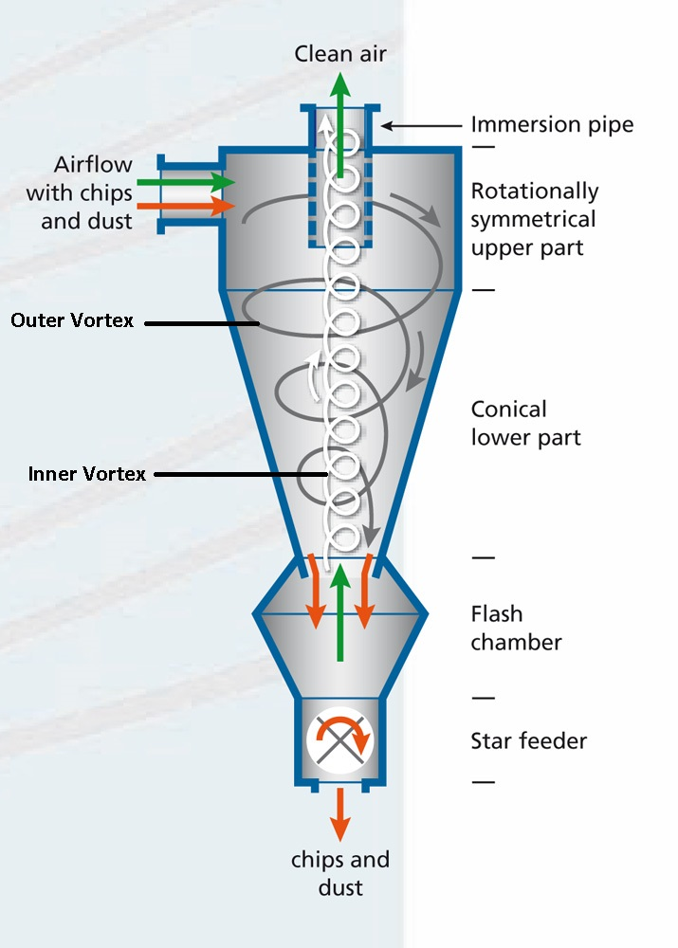
CONTROL EQUIPMENTS
CYCLONE SEPARATOR
a. Single Cyclone Separators
They create a dual vortex to separate coarse from fine dust.
The main vortex spirals downward and carries most of the coarser dust particles. The inner vortex, created near the bottom of the cyclone, spirals upward and carries finer dust particles.
Centrifugal force is utilized by them to separate the particulate matter from the polluted gas.

Slide 24
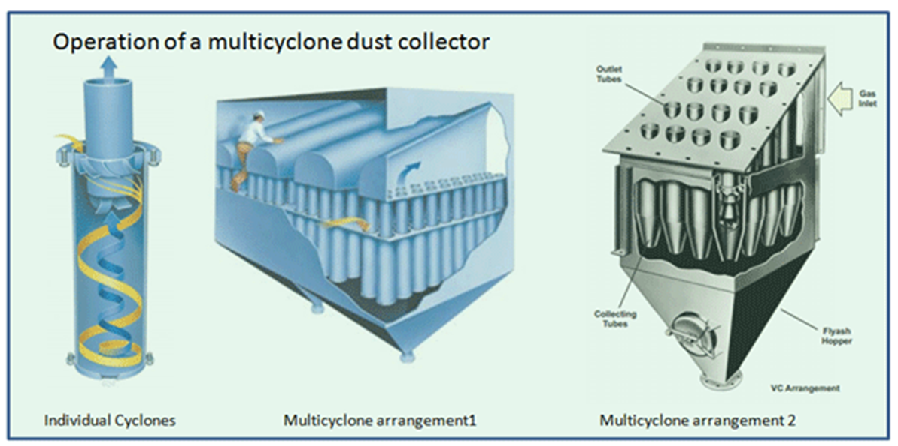
CONTROL EQUIPMENTS
CYCLONE SEPARATOR
b. Multiple Cyclone Separators
They consist of a number of small-diameter cyclones, operating in parallel and having a common gas inlet and outlet, as shown in the figure, and operate on the same principle as single cyclone separators—creating an outer downward vortex and an ascending inner vortex.

Slide 25
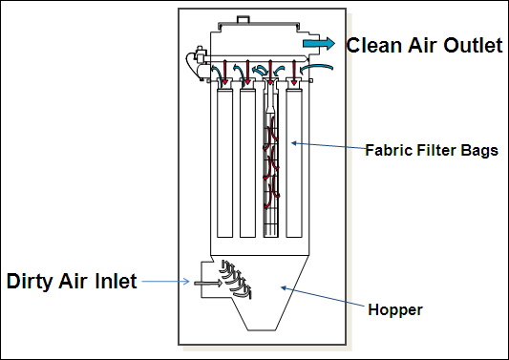
CONTROL EQUIPMENTS
FABRIC FILTERS (BAGHOUSE FILTERS)
They use filtration to separate dust particulates from dusty gases. They are one of the most efficient and cost effective types of dust collectors available and can achieve a collection efficiency of more than 99% for very fine particulates.
Dust-laden gases enter the baghouse and pass through fabric bags that act as filters. The bags can be of woven or felted cotton, synthetic, or glass-fiber material in either a tube or envelope shape (like thin like letter).
The particulate matter is left in the form of a thin dust mat on the insides of the bag. This dust mat further acts as a filtering medium.
The efficiency of the filter gag to sieve particles of 0.5 µm. Filter bags must be cleaned occasionally by a mechanical shaker

Slide 26
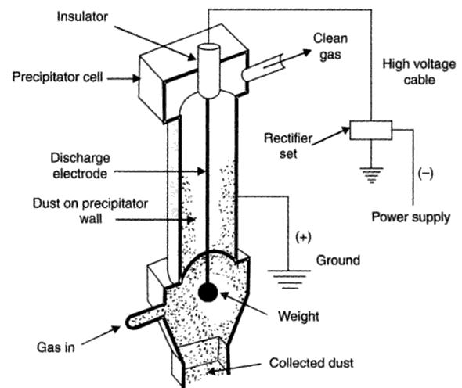
CONTROL EQUIPMENTS
ELECTROSTATIC PRECIPITATOR
A number of high-voltage, direct-current discharge electrodes are placed between grounded (positively charged) collecting electrodes.
The first electrode is charged to a very high negative voltage (center electrode) As the dirt particles move past it, they pick up a negative charge.
The negative ions migrate towards the grounded surface and pass on their negative charge to the dust particles also. Then these negatively charged dust particles are electrostatically drawn towards the positively charged collector surface, where they finally get deposited.
The collecting surface is vibrated periodically to remove the collected dust particles.

Slide 27
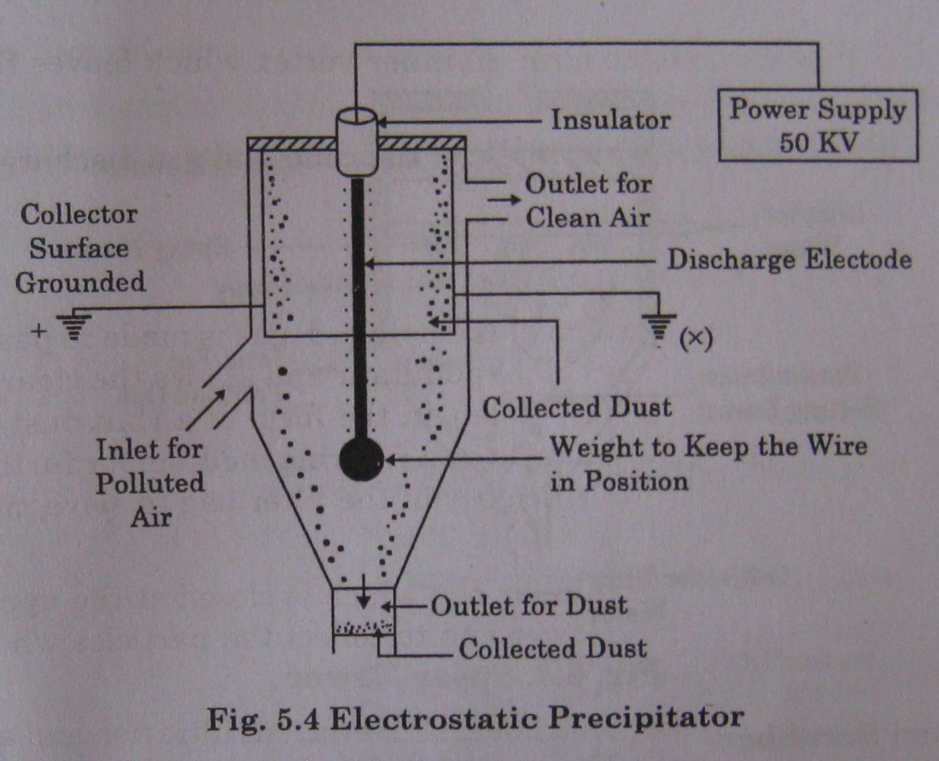

Slide 28
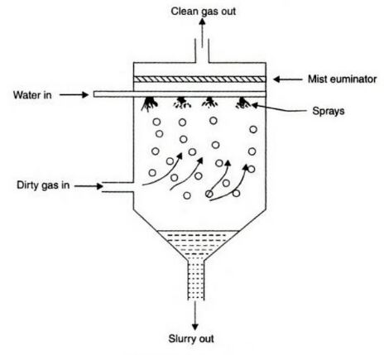
CONTROL EQUIPMENTS
WET SCRUBBERS
a. Spray Tower
Water is introduced into a spray tower by means of a spray nozzle.
As the polluted gas flows upwards the particulates (>10 µm) present collide with the water droplets being sprayed downward from the spray nozzles.
Under the influence of gravitational force, the liquid droplets containing the particulates settle to the bottom of the spray tower.

Slide 29
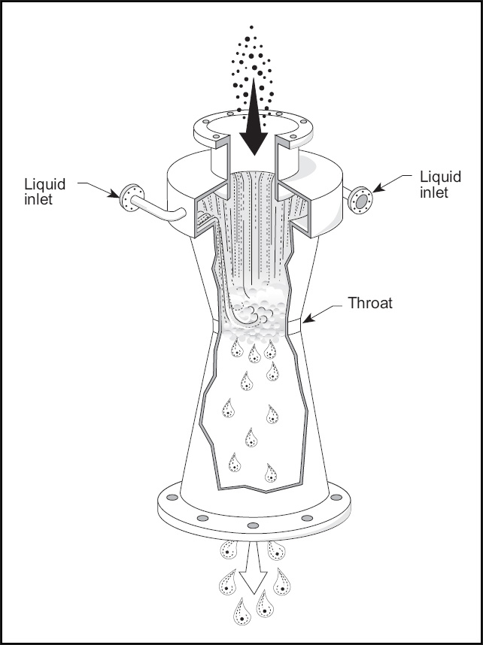
CONTROL EQUIPMENTS
WET SCRUBBERS
b. Venturi Scrubber
It removes the particulates of size 0.5 to 5 µm associated with smoke and fumes very efficiently.
Polluted gas speed passing through venturi = 60 –180 m/s.
A coarse water stream is injected upwards into the throat.
The particles collided with liquid droplets get entrained in the droplets and fall down to be removed later on.
To separate the droplets carrying the particulate matter from the gas stream, this gas-liquid mixture is then directed into a separation device such as a cyclone separator.

Slide 30
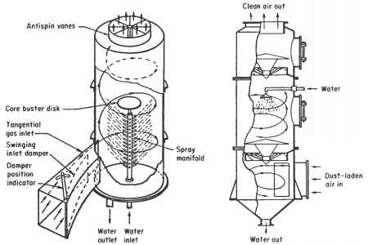
1.6.2. CONTROL EQUIPMENTS
WET SCRUBBERS
Cyclone Scrubber
High pressure nozzles generate a fine spray that intercepts the small particles in the polluted gas.
The centrifugal force throws these particles towards the wall from where they are drained downwards to the bottom of the scrubber.

Slide 31

Animated Display

Slide 33
Kathmandu’s Air Quality
Main problem is Particulate Matter
High PM2.5 to PM10 ratio
In dry season, PM10 in Putali Sadak is above national standards 99 % & in Thamel 90 % of the days
SOx, NOx, levels are below WHO guideline
Benzene & PAH levels may be a problem
Vehicle emission is the main concern

Slide 34
Kath AQMM: National AAQS
Parameter | AVG Time | Conc., Max. | Conc., Max. (WHO,2005)
TSP | 24 hour | 230 µg/m³
PM2.5 | Annual 24 hour |  | 10 µg/m³ 25 µg/m³
PM10 | Annual 24 hour | 120 µg/m³ | 20 µg/m³ 50 µg/m³
NO2 | Annual 24 hour | 40 µg/m³ 80 µg/m³ | 40 µg/m³ 200 µg/m³ (1-hour)
SO2 | Annual 24 hour | 50 µg/m³ 70 µg/m³ | 20 µg/m³ 500 µg/m³ (10-min)
CO | 8 hour 15 minute | 10,000 µg/m³ 100,000 µg/m³
Lead | Annual | 0.5 µg/m³
Benzene | Annual | 20 µg/m³
Ozone | 8-hour |  | 100 µg/m³

Slide 35
More than half of the burden from air pollution on human health is borne by people in developing countries. In many cities, the average annual levels of PM₁₀(the main source of which is the burning of fossil fuels) exceed 70 micrograms per cubic metre. The guidelines say that, to prevent ill health, those levels should be lower than 20 micrograms per cubic metre .
24 hourly values shall be met 95% of the time in a year. 18 days per calendar year the standard may be exceeded but not on two consecutive days

Slide 36

Major Issues Regarding AQM in Nepal
Very little information on AQ outside KTM
Kathmandu lacks a comprehensive action plan for air quality management
Coordination among various stakeholders is necessary
Inadequate technical human resources
Thank You

Slide 37
REFERENCES
Rao, C.S. (2006). Environmental Pollution Control Engineering. New Delhi: New Age International (P) Ltd.
Dust Collector. (n.d.). In Wikipedia. Retrieved December 13, 2016, from https://en.wikipedia.org/wiki/Dust_collector# Types_of_dust_collectors
Ale, B. B. (2008). Presentation on Air Pollution Control Methods and Equipment

Slide 38
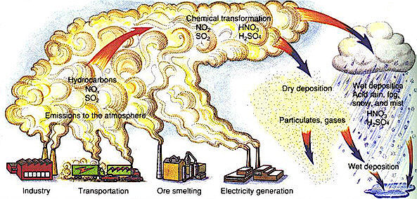

Slide 39
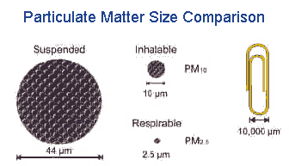
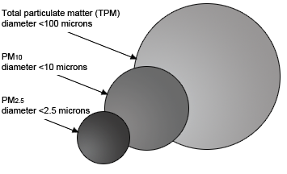

Slide 40
PM’s may reduce visual amenity and adversely impact health .
Most urban particulates have size in the range 0.1 to 10µm
The smallest and the finest particles are the ones which cause significant damage to health
Large particles settle out of the air quickly while smaller particles may remain suspended for days or months .

Slide 41
GRAVITATIONAL SETTLING CHAMBER
Used for removing particles exceeding 50 µm in size from polluted gas stream .
The particles having higher density obey Stoke’s law and settle at the bottom of the chamber from where they are removed ultimately.
The several horizontal shelves or trays improve the collection efficiency by shortening the settling path of the particles.

Slide 42
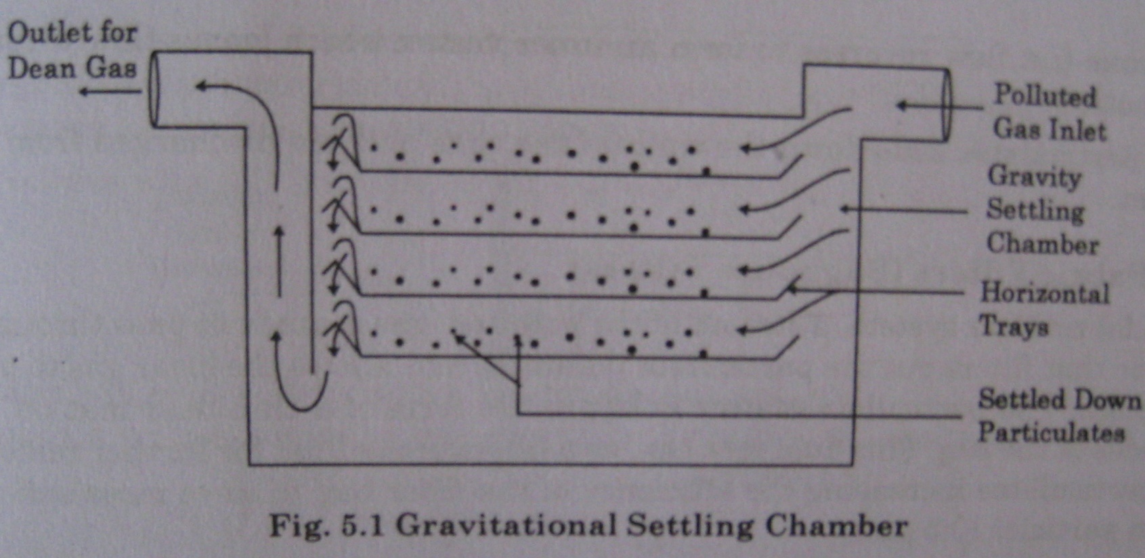

Slide 43
CYCLONE SEPARTORS (REVERSE FLOW CYCLONE)
Instead of gravitational force, centrifugal force is utilized by cyclone separators, to separate the particulate matter from the polluted gas
The dust laden gas enters tangentially, receives a rotating motion and generates a centrifugal force due to which the particulates are thrown to the cyclone walls as the gas spirals upwards inside the cone.
The particulates slide down the walls of the cone and are discharged from the outlet.

Slide 44
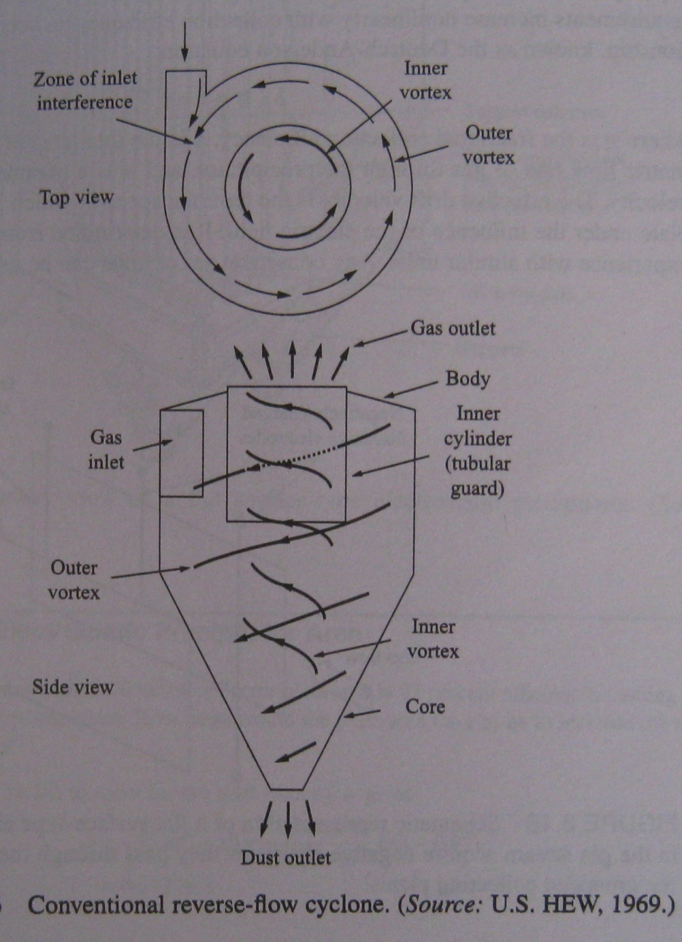

Slide 45
FABRIC FILTERS (BAGHOUSE FILTERS)
A stream of the polluted gas is made to pass through a fabric that filters out the particulate pollutant and allows the clean gas to pass through.
The particulate matter is left in the form of a thin dust mat on the insides of the bag. This dust mat acts as a filtering medium for further removal of particulates increasing the efficiency of the filter gag to sieve particles of 0.5 µm.
For efficient filtration and a longer life the filter bags must be cleaned occasionally by a mechanical shaker to prevent too many particulate layers from building up on the inside surface of the bag.

Slide 46
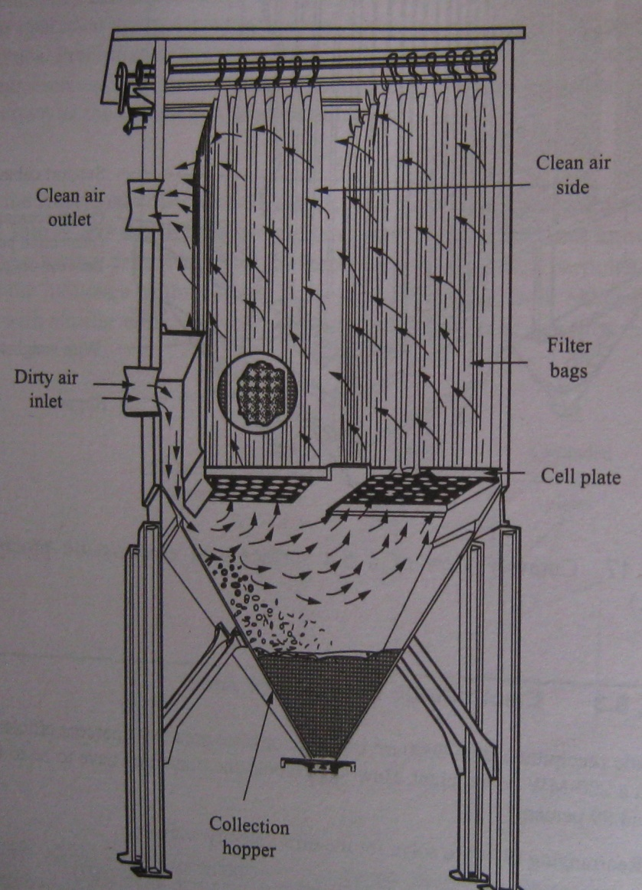
Fabric Filters

Slide 47
ELECTROSTATIC PRECIPATATORS
It works on the principle of electrostatic precipitation; i.e. electrically charged particulates present in the polluted gas are separated from the gas stream under the influence of the electrical field.
The polluted gas enters from the bottom, flows upward. The high voltage in the wire ionizes the gas. The negative ions migrate towards the grounded surface and pass on their negative charge to the dust particles also. Then these negatively charged dust particles are electrostatically drawn towards the positively charged collector surface, where they finally get deposited.
The collecting surface is vibrated to periodically to remove the collected dust particles to maintain the dust layer less than 6mm for better efficiency.

Slide 48
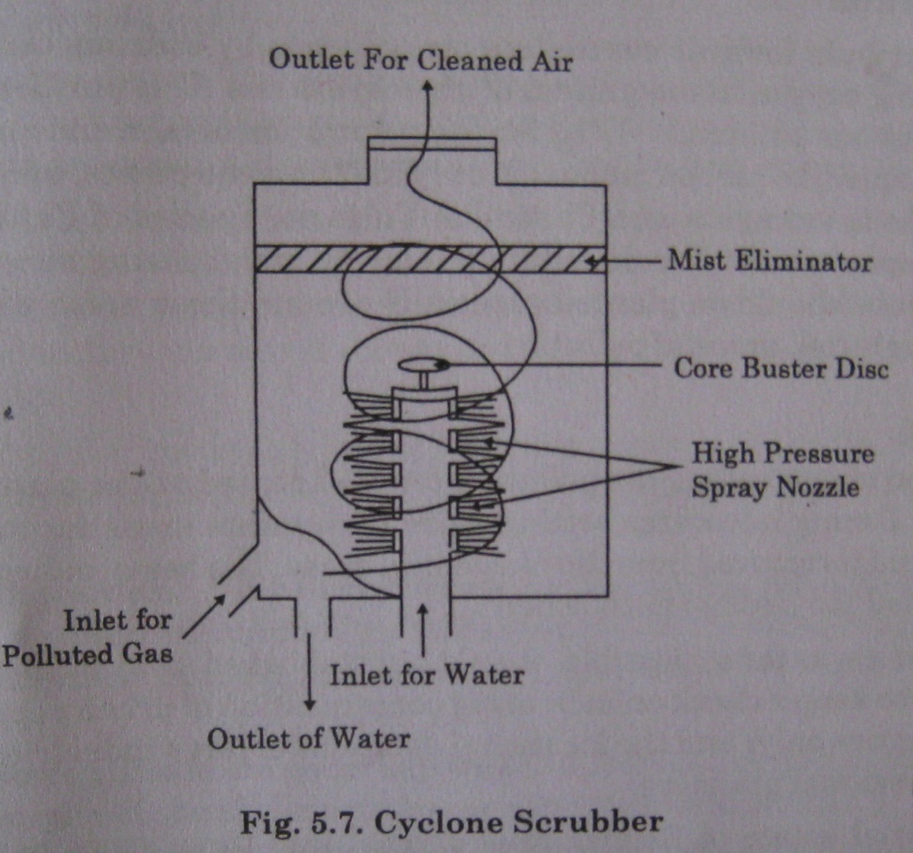
WET COLLECTOR – CYCLONE SCRUBBER
High pressure nozzles generate a fine spray that intercepts the small particles in the polluted gas.
The centrifugal force throws these particles towards the wall from where they are drained downwards to the bottom of the scrubber.

